Slide 1

TESTING AND MONITORING BASED METHODOLOGY FOR WEB APPLICATIONS PERFORMANCE IMPROVEMENT
FACULTY OF AUTOMATION AND COMPUTER SCIENCE
COMPUTER SCIENCE DEPARTMENT
Graduate: Eng. Mihaela CIUGUDEAN
Supervizor: Prof.Dr.Eng. Dorian GORGAN

Slide 2
Contents
Introduction
Project Objectives
Theoretical Considerations
State of the Art
Technological Considerations
Implementation Considerations and Experimental Results
Conclusions
Bibliography
Appendix

Slide 3

Introduction
Motivation: preserve the stability and other quality features of existing system in the context of considerably increasing the number of concurrent users
Why this methodology ?!
economical considerations: no major investments in new hardware/equipment/licenses
technical considerations: use the existing system instead of starting from scratch

Slide 4
Project Objectives
Prerequisite: License Thesis
electronic Scrum tool, using Java technologies, intended to construct a system behaving as an Agile project organizer
Objectives
monitor and evaluate performance characteristics through specialized tools
maximize system’s performance through a suite of dependent methodologies
the developed improvements reside in different areas of the system and might be assessed together or in isolation
assess the outcome of each phase through performance monitoring tools and measurements

Slide 5

Theoretical Considerations
APM Meaning
art of managing performance, availability, serviceability, response time and the overall user experience
in thesis context: interconnection of tools, processes and methodologies used to evaluate systems’ quality features by taking into account performance-oriented metrics
APM Advantages
reduced downtime, thus providing business continuity
improves User Experience (UX) and Satisfaction
enhances innovation
reduces operational costs
higher productivity
significant increase in sales and revenue

Slide 6
State of the Art - in Literature
Sydor’s APM Best Practices: Realizing Application Performance Management book [1]
overview of APM development
the extension of the Internet and development of system’s complexity and distribution, determined the need of change in the area of traditional monitoring
previously used tools become inaccessible and were not able to successfully handle all application performance issues
improve next generation of monitoring tools, more specialized and offering brand new features aiming to overcome the limitations of traditional monitoring
impressive attention was given to transactions and user experience
Waller’s Performance Benchmarking of Application Monitoring Frameworks [2]
both theoretical and technical insights related to system monitoring approaches
references to similar APM tools used in application instrumentation, profiling and monitoring (e.g. VisualVM)
overhead caused by APM
Shields’s The Definitive Guide to Application Performance Management [3]
overview of APM from End-Users Experience (EUE) viewpoint
APM integration into the system
APM role inside a real project and its communication with business

Slide 7
State of the Art - on the market
APM Tools
JMeter vs LoadRunner
JMeter - unlimited load generation, free usage, intuitive UI
LoadRunner - limited load generation capacity, provides a suite of extended developed features at an expensive price, sophisticated UI
JConsole vs VisualVM vs AppDynamics Lite
JConsole - easy to navigate UI, free usage, lacks application context, causes extra overhead
VisualVM - extends JConsole functionalities, easy to navigate UI, free usage, causes extra overhead
AppDynamics Lite - exhibits a top down approach to monitoring, free usage, does not cause overhead

Slide 8
Technological Considerations
Tools used on behalf of the Research and Experiments conducted
Apache JMeter
VisualVM
Technologies used in License Thesis development
Spring Framework
Java Persistence API (JPA)
Technologies used in Dissertation Thesis development
Apache Load Balancing
Eh-Cache
Spring Eh-Cache
Hibernate Eh-Cache

Slide 9
Implementation Considerations and Experimental Results
Solution
implementing a suite of phases oriented towards improving the application’s performance capabilities
phase - methodology for analyzing and implementing the most suitable solution
at completion of each phase specialized performance measurements were conducted in order to evaluate the enhancements obtained, as well as their magnitude
Evaluation
a suite of use cases considered
target: assess system’s performance under heavy load
handle big data accessed by large amount of concurrent users

Slide 10
Implementation Considerations and Experimental Results (cont.)
Evaluation (cont.)
main test scenario
login as admin user (e.g. Scrum Master)
perform various activities with repetitive retrieval of large amount of data (information corresponding to 1000 developers)
simultaneously executed by large number of users (10, 50, 100)
metrics
throughput
error percentage
response time
initial state of the application taken as reference in performance assessment
enhancement concluded in case
throughput increased
error decreased
response time reduced

Slide 11
Implementation Considerations and Experimental Results (cont.)
phase 1
initial evaluation of the software application, which was intended to be considerably improved
JMeter tests indicated a severe penalty behavior when increasing the workload, here expressed as amount of user requests
high error percentage
low throughput
phase 2
aimed to remove, or at least reduce, the threat affecting the application’s operation when an increased number of concurrent users try to access it
review the initial source code so that to identify possible performance vulnerabilities
completed with a cleaner, error-free code base due to implemented code improvements
phase 3
evaluate performance capabilities after the improvements were implemented
JMeter tests reported no performance enhancement obtained
error percentage considerably increased (from 19.85% to 30.77%)
same or lower throughput

Slide 12
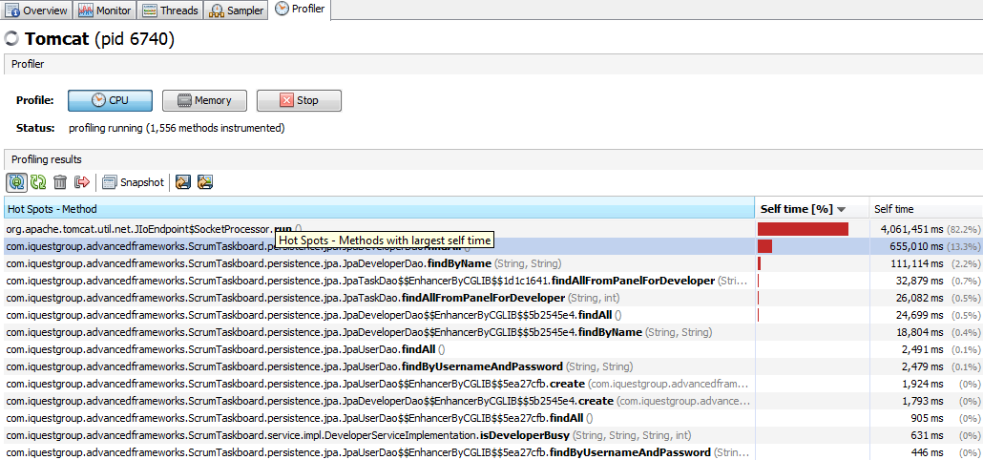
Implementation Considerations and Experimental Results (cont.)
phase 4
execute performance tests using JMeter’s console mode
results indicated an enhanced performance vulnerability
error percentage slightly increased (from 54.55% to 55.45%)
throughput decreased even more
phase 5
advanced application monitoring using VisualVM tool, intended to obtain accurate information regarding the system’s bottlenecks
JMeter & VisualVM measurements denoted the need of improvements at database level

Slide 13
Implementation Considerations and Experimental Results (cont.)
phase 6
explore and develop several database indexing approaches
dedicated performance experiments determined their suitability
DB indexing aim: lowest error
errors for different DB indexing configurations and concurrent users
phase 7
apply Spring Eh-Cache on the system
experiments reported both positive and negative results
+ : 0% error for 100 concurrent threads
- : large response time (2 - 3 hours)
Error percentage for | 100 threads | 300 threads | 500 threads
No Index | 0% | 20.04% | 61.18%
Index for username | 0% | 16.00% | 60.17%
Index for password | 0% | 23.62% | 56.60%
Index for username + Index for password | 0% | 13.33% | 58.53%
Composite index from username and password | 0% | 17.29% | 56.60%

Slide 14
Implementation Considerations and Experimental Results (cont.)
phase 8
implement Hibernate Eh-Cache for a Java entity model class
explore cache statistics and conclude the proper cache usage
unsatisfactory result, as the target of reducing the use case’s execution time was not accomplished
+ : 0% error for 100 concurrent threads was preserved
- : response time increased (more than 3 hours)
phase 9
develop a load balancing solution
several cluster configurations
final setup: Apache load balancer and 3 Tomcat server instances (2 on the localhost and 1 belonging to a remote host)
performance measurements proved a significant improvement
use case’s response time reduced with about 30 minutes
23.8% performance enhancement

Slide 15
Conclusions
research defined as continuous process of monitoring and improving system’s performance features
specialized performance tests completed each phase and concluded accurate results concerning the enhancements obtained
both successful and negative outcomes were obtained
all results were considered successful as they offered the opportunity to practically explore various software engineering methodologies and gather insights into Application Performance Monitoring area
general conclusion: the proposed methodology, applied to an existing system, is considered successful because significant gains were obtained with minimum invested effort

Slide 16
Bibliography
[1] Sydor, M.,J., APM Best Practices: Realizing Application Performance Management, Apress, 2010.
[2] Waller, J., Performance Benchmarking of Application Monitoring Frameworks, Books on Demand, 2014.
[3] Shields, G., The Definitive Guide to Application Performance Management, Realtime Publishers, 2009.
[4] Higgins, K. R., An Evaluation of the Performance and Database Access Strategies of Java Object-Relational Mapping Frameworks, ProQuest, 2007.
[5] Membrey, P., et al., Practical Load Balancing: Ride the Performance Tiger, Apress, 2012.
…

Slide 17
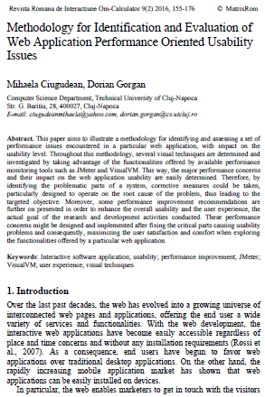
Appendix
[1] Ciugudean, M., Gorgan, D., Methodology for Identification and Evaluation of Web Application Performance Oriented Usability Issues, in Romanian Journal of Human Computer Interaction 9(2) 2016, 155-176.

Slide 18
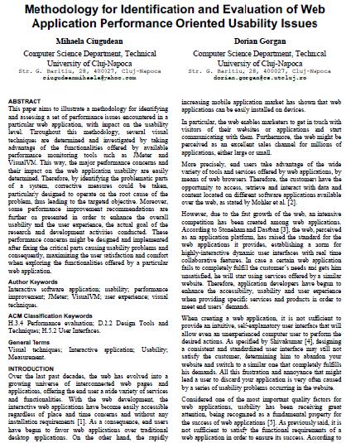
Appendix (cont.)
[2] Ciugudean, M., Gorgan, D., Methodology for Identification and Evaluation of Web Application Performance Oriented Usability Issues, in Proceedings to ROCHI Conference, 8-9 Sept., Iasi, 2016.

Slide 19


